Slide 1
What is your BiG idea?

Slide 2
What is creativity?
Creativity is the use of imagination and the generation of new ideas - in this case, coming up with new ideas for new products and services and creative ways of improving what you already have
Skills Builder Creativity Skill Summary Video
There’s an award for teams who can show us their brilliant creativity skills!

Slide 3
Your business plan How to come up with a good business idea!
What are you good at?
What do you enjoy doing?
Will people buy your idea?
Have you got access to what you need to make your product or deliver your service?

Slide 4
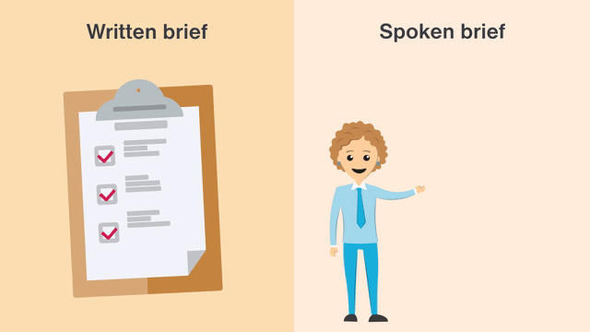
Skills Builder – Creativity Imagining and generating ideas
I generate ideas when I’ve been given a clear brief
Part 1 - What is a creative brief?
Part 2 - How to generate ideas for a brief

Slide 5
Imagining and generating ideas Things to consider
What is meant by a brief?
How can a brief be helpful?
Have I worked from a brief before?
How can I create ideas to fulfil a brief?
What should I do and what should I avoid doing?
Have I done this before?
How did it go?

Slide 6
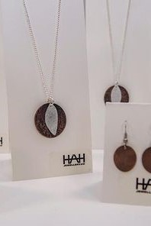
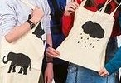
Business ideas Examples - accessories
What are your ideas?

Slide 7
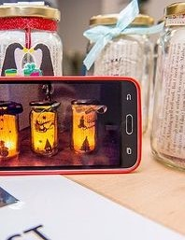
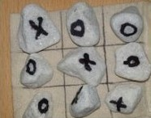
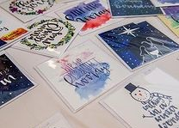
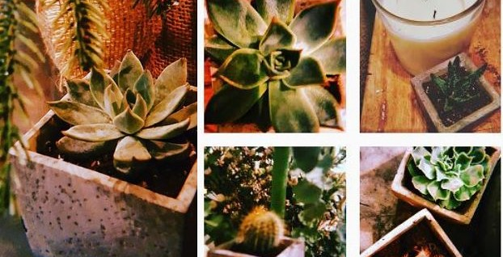
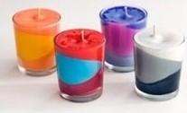
Business ideas Examples - Decorations & gifts

Slide 8
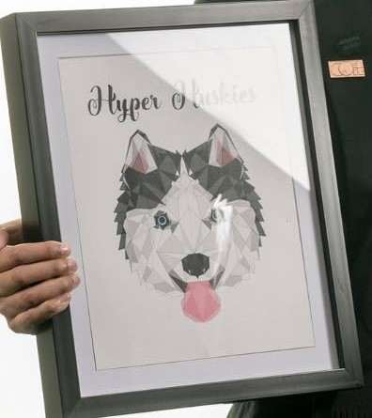
Business ideas Examples – Pet accessories
Have you got an idea yet?
Do you know your team strengths?
Have you got a plan?

Slide 9
Safety first! Anyone selling items to the public has to follow laws set out by the Government.
Some of these rules include:
Food and cosmetics have extra rules that you have to follow about what you must tell people in your packaging.
We do not allow any teams to make toys for children, nightwear or imitation (pretend) food (for example: bath bombs that look like cup cakes)
Teams cannot use alcohol, tobacco or gas related products
Teams cannot run any gambling activities but can run raffles in school
Copyright – to use or make some items, you have to have permission from the original person that made it. For example, you cannot use the Nike logo unless you have permission from Nike
BiG Challenge Competition Terms

Slide 10
Made in Sheffield Sheffield is famous for its history of making high quality items
As part of the final awards, there is a Made in Sheffield Award.
For your business idea to be considered, your products have to be made in Sheffield.
Ideas that use existing items and re-package them into something new (e.g. chocolate bars re-packaged into a gift pack) will not be eligible for this award but will still have lots of chances for other awards including the BiG prize!

Slide 11
Test your idea

Slide 12
Skills Builder – Creativity Imagining and generating ideas
I generate ideas to improve something
Part 1 - Understanding the success criteria
Part 2 - Making something better, using success criteria

Slide 13
Improving something I already have Things to consider
What are success criteria?
How can we work out what success looks like for different things?
How can we come up with lots of ideas?
How do we know if an idea will make something better or not?
Have I done this before and what was the outcome?

Slide 14
Market research Who are your customers?
To make money, you need customers.
Market research is where you talk to people you think would buy your product to find out:
Would they buy your product/service?
How much would they pay for it?
Where would you advertise or sell your product to get lots of customers?
Is someone already making this product?
Is there a gap in the market?

Slide 15
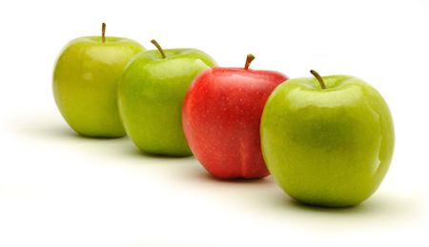
Unique Selling point
This is where you think about what is special about your product/service that would help you to win customers:
If no-one else is doing what you are doing, that makes your idea unique
If there are lots of people selling the same thing, you need to make your product/service stand out.
How can you make your business idea stand out from the crowd?

Slide 16
Have you entered?
Don’t forget to enter your team details and ideas on the:
BiG Challenge website!

